Slide 1
TRANSBULBAR ULTRASOUND:
A useful Tool in Multiple Sclerosis
Fabienne Perren, MD, PhD*
Laboratory of Ultrafast ultrasound Imaging in Clinics, LUNIC Laboratory, Neurocenter of Geneva,
Medical Faculty of the University of Geneva and Freiburg, Switzerland
* The Presenter has no conflict of interest & nothing to disclose
Laboratory of ultrafast-Ultrasound Neuroimaging
In Clinics
LUNIC
LCNS

Slide 2
Introduction
Multiple sclerosis (MS) is a heterogeneous disease with an unpredictable course.
A vision problem is the first symptom of MS for many people.
Visual pathway is a target of the disease and may reflect mechanisms that lead to disability.
Structural and functional changes in the visual pathway may be studied by noninvasive techniques such as B‐mode transorbital sonography (TOS).

Slide 3
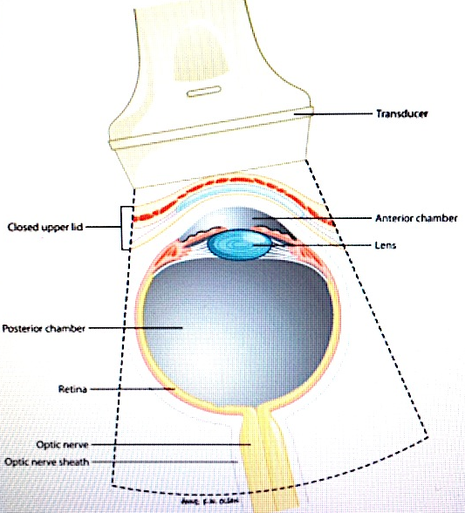
Introduction
Since the 60’s: ophtalmologists (vitreous hemor. & lens opacification)¹
TCD Insonation through orbita with a 2 MHz PW probe in the early 80’s (intracranial ICA)²
US technique needed long time to adapt power for safety
Possible thank improved B-mode, lower transmission of energy
In recent years, neurologists interested in clinical information (papilledema, ON structure, intraorbital vessels)³
1. AJR 1991;157:1079-86; 2. J Neurosurg 1982; 57: 769-774; 3. Ultraschall Med 2014;35:422-431

Slide 4
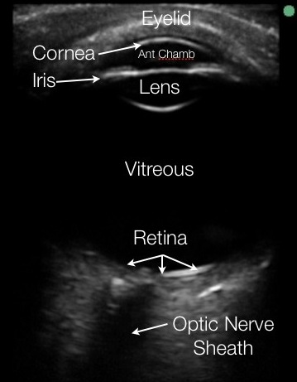
Background
Transorbital sonography (TOS) has emerged as a promising assessment tool of the optic nerve and orbital arterial supply in multiple sclerosis (MS) patients.
In less than 5 years, several studies using TOS have aimed to assess changes in the visual pathway in eyes of MS patients

Slide 5
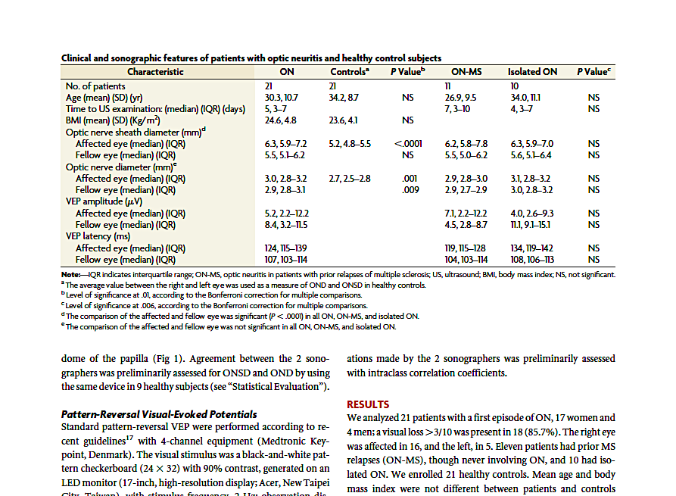
TOS and Optic neuritis (ON)
21 patients with a first episode of ON.
17 women and 4 men.
Visual loss 3/10 was present in 18 (85.7%). The right eye was affected in 16, and the left, in 5.
11 patients had prior MS relapses (ON-MS), though never involving ON, and 10 had isolated ON.
21 healthy controls.
Mean age and body mass index were not different between patients and controls
TOS revealed papilledema in 9 patients (43%), 8 on the right side, and in none of the controls.
AJNR Am J Neuroradiol 35:2371–75 Dec 2014

Slide 6
TOS and Optic neuritis (ON)
AJNR Am J Neuroradiol 35:2371–75 Dec 2014

Slide 7
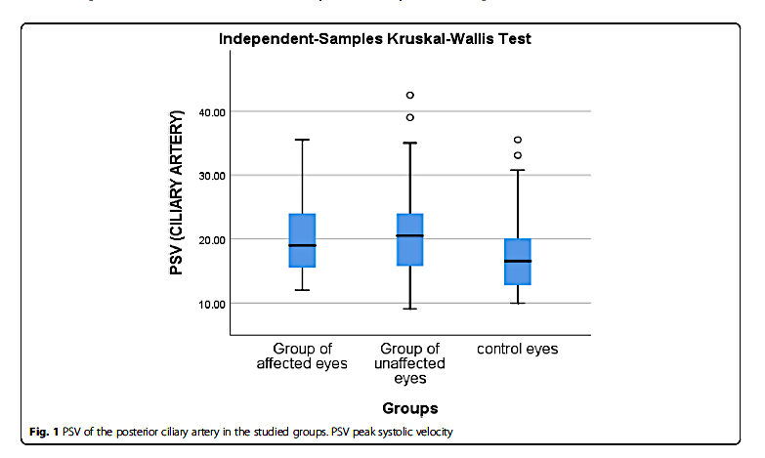
TOS and Optic neuritis (ON)
The mean age of MS patients was 33.75 ± 9.43 years
while the mean age of controls was 33.25 ± 6.12 years;
Duration of the disease ranged from 1 to 27 years (mean 8.25 ± 6.59 years).
Duration since optic neuritis attack in patients with previous ON ranged from 1 to15 years (mean 4.3 ± 3.36 years).
EDSS of patients ranged from 1.5 to 7 (mean EDSS of 4.11 ± 1.89).
(p value = 0.002, 0.002, and 0.022)
Eyes of MS patients had significant lower OND and ONSD than control eyes (p value = 0.032, 0.023) respectively.
Egyp j neurol psych neurosurg 2019, 55.66

Slide 8
TOS and Optic neuritis (ON)
Egyp j neurol psych neurosurg 2019, 55.66

Slide 9
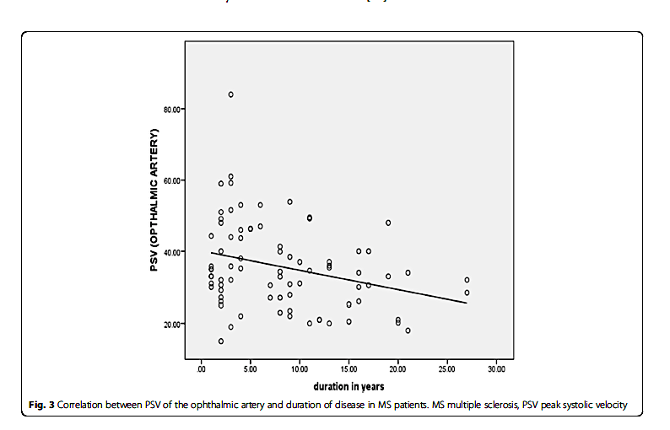
TOS and Optic neuritis (ON)
Egyp j neurol psych neurosurg 2019, 55.66

Slide 10
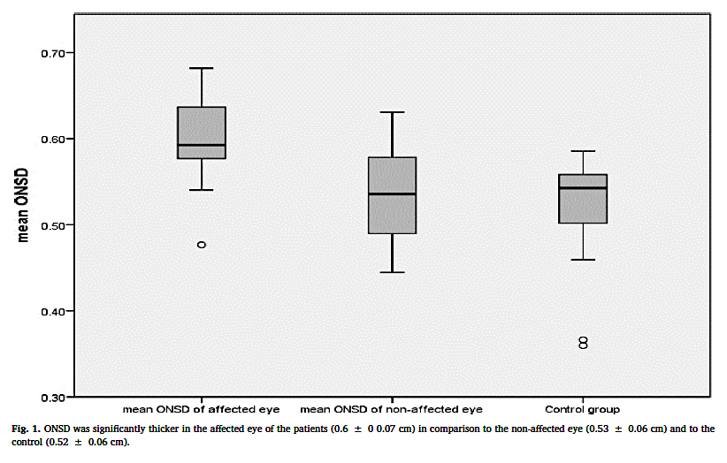
TOS and Optic neuritis (ON)
Multiple Sclerosis and Related Disorders (2020) 101934

Slide 11
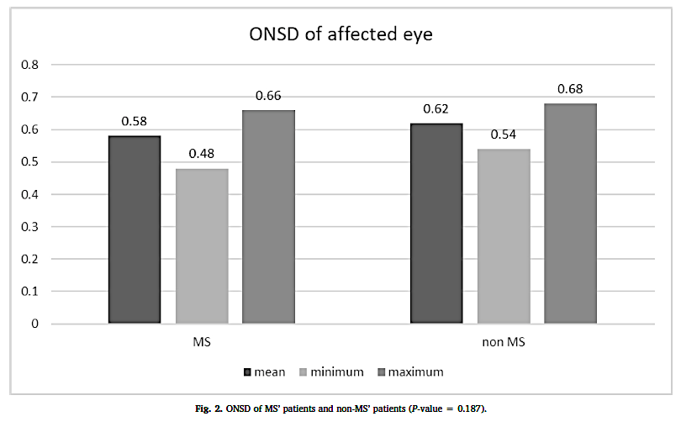
TOS and Optic neuritis (ON)
Multiple Sclerosis and Related Disorders (2020) 101934

Slide 12
TOS in MS without optic neuritis
Participants examined in the supine position with elevated upper part of the body and the head angle held constant at 20–30 degrees to avoid any pressure on the eyes.
All participants were asked to try to keep their eyes in the mid position.
Mechanical index was reduced to 0.2.
Brain Res 2020; 1734, 146723

Slide 13
TOS in MS : visual acuity and biomarkers of inflammation
Hindawi Disease Markers, 2017; ID 5434310; Clinical Neurophysiology 2016;127(1: 803–809

Slide 14
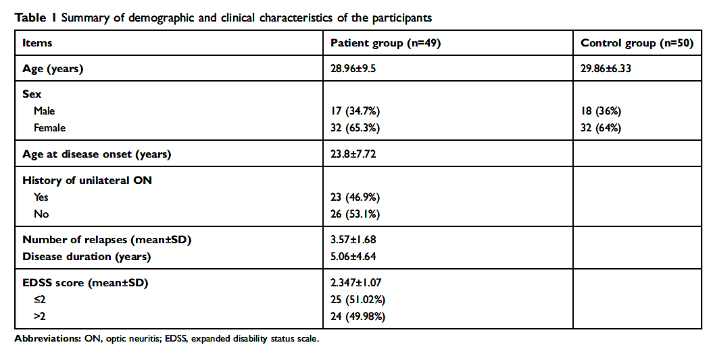
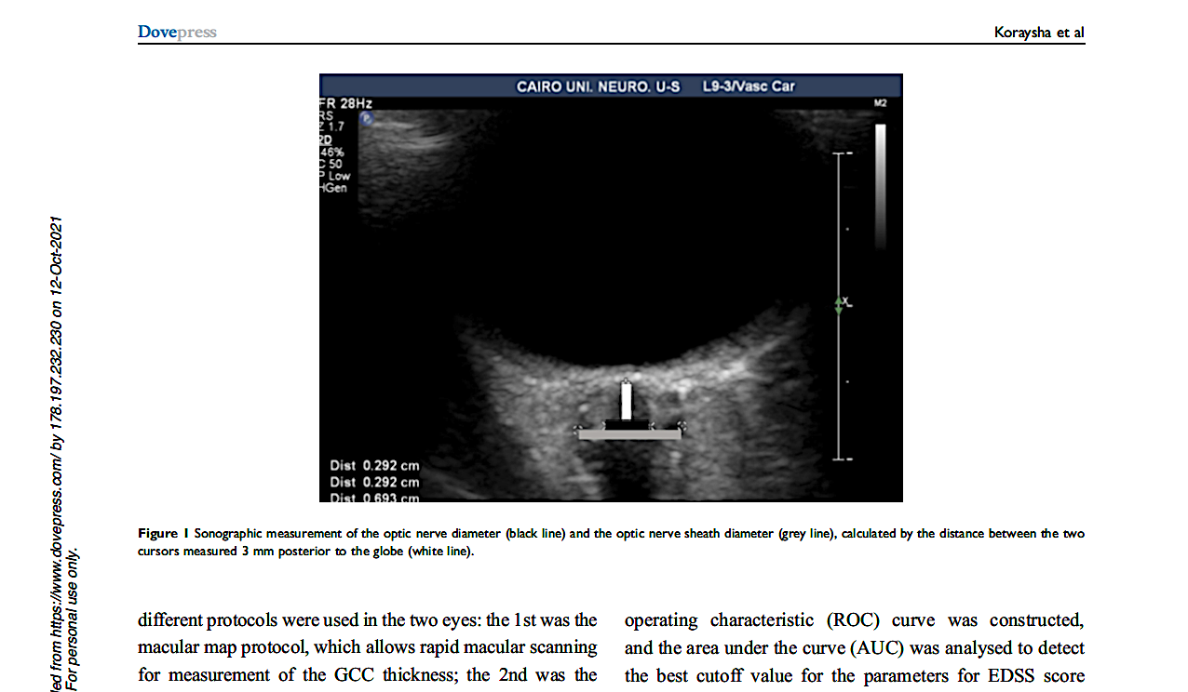
TOS evaluation of OND as a in biomarker for disability in MS
Neuropsychiatric Disease and Treatment 2019;15:2571-78

Slide 15
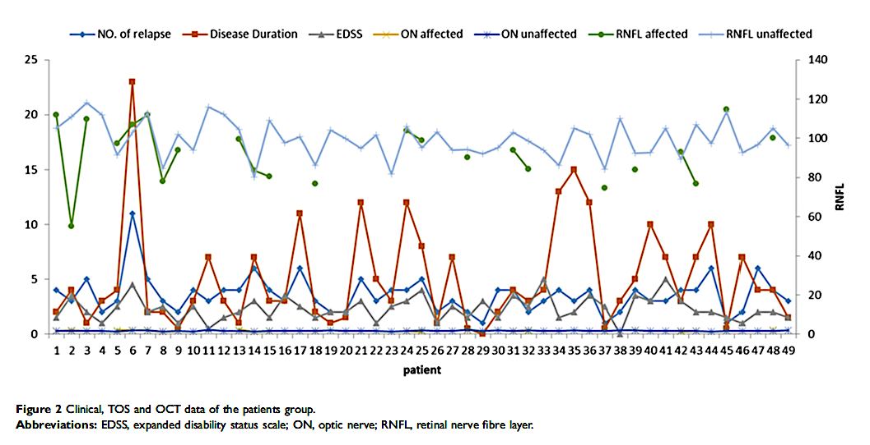
TOS evaluation of OND as a in biomarker for disability in MS
Neuropsychiatric Disease and Treatment 2019;15:2571-78

Slide 16
TOS detecting ON atrophy in demyelinating diseases
Total of 78 patients with a history of CNS demyelinating disease, 58% with a history of MS and 26% with a history of NMOSD
19 patients with acute ON and 59 patients without evidence of acute ON (mean age 38.2 14.2 years, 64.1% females, mean EDSS score 3.7 2.1) resulting in a data pool of 156 optic nerves.
The median time from symptom onset to TOS examination was 10 days, interquartile range (IQR) 6–25 days.
Patients with acute ON were younger (32.4 13.3 years vs. 40.1 14.1 years, P = 0.039), less frequently under treatment (26.3% vs. 61.0%, P = 0.008) and had significantly higher rates of previous ON (36.8% vs. 11.9%, P = 0.014) than patients without acute ON
Eur J Neurology 2020; 27:626-32

Slide 17
TOS detecting ON atrophy in demyelinating diseases
ROC analysis of the presence of papillary swelling was found to yield a sensitivity of 14.29% and a specificityof 98.52% for the diagnosis of acute ON.
Eur J Neurology 2020; 27:626-32

Slide 18
Shear wave elastography in optic neuritis
72 eyes of 36 patients diagnosed with unilateral optic neuritis
age-matched control group of 36 eyes of 18 healthy subjects.
The patient group consisted of 25 multiple sclerosis patients and 11 recurrent isolated optic neuritis patients.
TI values (<0.5) and MI values (<0.21) were below the FDA limits for ocular US applications
J Ultrason 2021; 21: e194–e199.

Slide 19
Shear wave elastography in optic neuritis
J Ultrason 2021; 21: e194–e199.

Slide 20
Conclusions
Transorbital sonography (TOS) and shear wave elastography : promising imaging methods for the diagnosis and follow-up of acute optic neuritis (ON).
Their large availability, portability and ability to monitor non-invasively and low cost make them an ideal supportive tool in the examination and follow up of ON patients.
Further larger studies should be performed to assess and confirm their role in the daily practice.

Slide 22
Thank You for Your Attention!
Sunset over the Lac Léman, 2018 F.P.

